Slide 1
Quality
A Module in Agile Fundamentals
Notes:
Welcome to Quality, a module in Agile Fundamentals. This module is brought to you by Twist, the testing platform from ThoughtWorks Studios.
In this module, we’ll explore the concepts of Quality in Agile Software Development, when it is applied, how it is applied, and how it affects the end result.

Slide 2
What is Quality?
Notes:
2 key principles
Fit for purpose
Right first time
Determined by the intended user
-----------------------------------------------------------------------------------------------
Once again, let’s start with some definition.
First, what is Quality in a business or engineering environment?
From Wikipedia, we get this definition:
Quality in business, engineering and manufacturing has a pragmatic interpretation as the non-inferiority or superiority of something. Quality is a perceptual, conditional and somewhat subjective attribute and may be understood differently by different people. Consumers may focus on the specification quality of a product/service, or how it compares to competitors in the marketplace. Producers might measure the conformance quality, or degree to which the product/service was produced correctly.
And also from Wikipedia, we get a definition of Quality Assurance:
Quality assurance, or QA for short, refers to planned and systematic production processes that provide confidence in a product's suitability for its intended purpose. It is a set of activities intended to ensure that products (goods and/or services) satisfy customer requirements in a systematic, reliable fashion. QA cannot absolutely guarantee the production of quality products, unfortunately, but makes this more likely.
Two key principles characterize QA: "fit for purpose" (the product should be suitable for the intended purpose) and "right first time" (mistakes should be eliminated). QA includes regulation of the quality of raw materials, assemblies, products and components; services related to production; and management, production and inspection processes.
It is important to realize also that quality is determined by the intended users, clients or customers, not by society in general: it is not the same as 'expensive' or 'high quality'. Even goods with low prices can be considered quality items if they meet a market need.

Slide 3
How we focus on quality
I automate the application of quality metrics against the codebase
I make sure resources are being used to address the most pressing issues for the team
Core
Team
Iteration Manager
I insist on being involved early in the project to ensure infrastructure requirements are captured
I ensure acceptance criteria are created for all stories
Tech
lead
Business Analyst
Infra. Lead
Tester
I make myself available frequently to see work in progress development
I work with team members to catch defects early, or prevent them happening at all
Bus. SME
Architect
Software
Engineer
I validate my design with working code, not pretty pictures
I don’t write a line of production code without an automated test around it
Notes:
Read through how each role contributes to quality of an application.
---------------------------------------------------------------------------------------------------------------------------
Of course, just stating that each person on an Agile team is responsible for overall quality doesn’t make it so. To back up the desire for a shared commitment to quality, many of the practices that the different roles play, and perhaps even more importantly, the time that they undertake these activities, all support the desire for quality to be collectively owned.
Note that for many of the roles, there are numerous other examples of a quality focus within an Agile team.

Slide 4
Types of Testing
Notes:
We will not define the different types of testing,
but we’ll discuss the difference between testing in Agile and testing in the traditional sense.

Slide 5
Types of testing
What types of testing do you do now?
Why do you do these types of testing?
Write each type of test on an index card along with a description of this test.
Be ready to share with the group.
Notes:
Prioritize stories into Minimum Marketable Features (MMF)

Slide 6
Types of Testing
Unit Testing
Acceptance Testing
System Integration Testing
User Acceptance Testing (UAT)
Regression Testing
Exploratory Testing
Notes:
Simultaneous learning, test design, test execution.
Traditional – pre-defined test cases
Agile –starting early in the process
Exploratory Testing - is an approach to software testing that is concisely described as simultaneous learning, test design and test execution.
While the software is being tested, the tester learns things that together with experience and creativity generates new good tests to run.
Most valuable defects are found during exploratory testing.
Traditional – Since testing is always done at the end of the development cycle, mostly testers will have time to execute pre-defined test cases and get very little time to do exploratory testing.
Agile – Since testing happens in parallel to development, testers have enough time to do exploratory testing.

Slide 7
Collaboration
Notes:
What is the typical testing process?
How can we collaborate on testing?
Or really, what happens when we don’t collaborate?

Slide 8
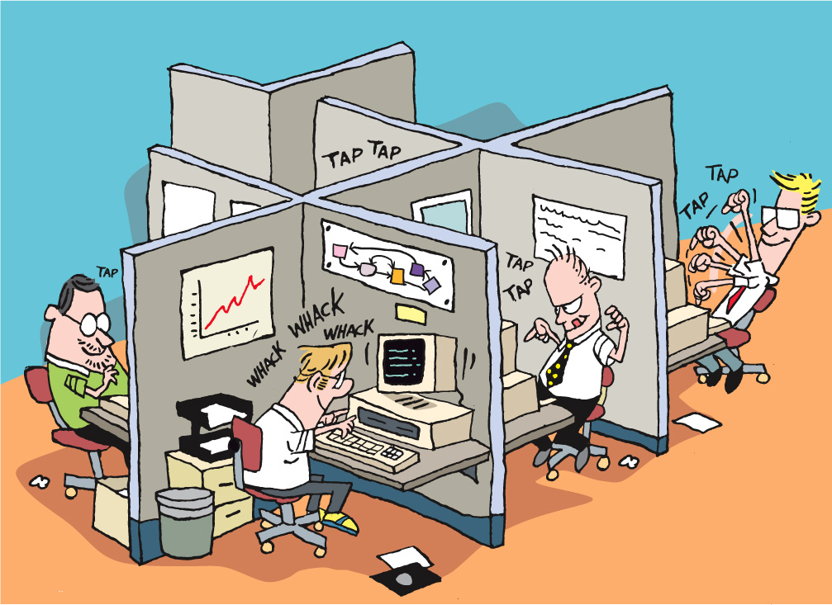
Physical separation / Lack of face-to-face communication
What can you do about it?
Integrate all capabilities into single collocated team, using conversation (e.g., standups) and shared storywall to show status of testing
Notes:
Physical separation means relationships between testers and developers cannot be built up effectively
Lack of face-to-face communication means communication is misinterpreted (especially bug reports) and exacerbated by physical separation

Slide 9
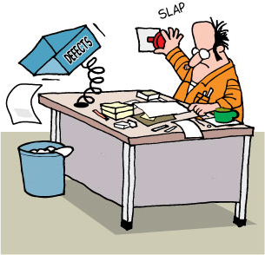
No shared responsibility towards quality
What can you do about it?
Heavy emphasis on developer testing of stories during development
Notes:
No shared responsibility towards quality means developers didn’t feel like testing was something they needed to do

Slide 10
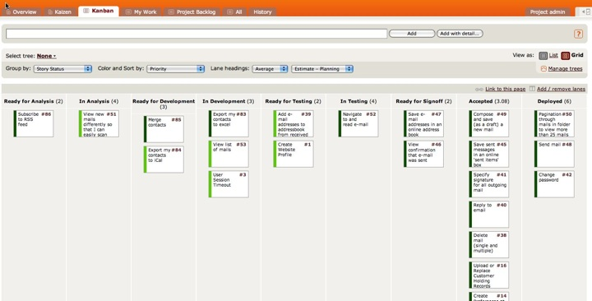
Misaligned metrics
What can you do about it?
Entire team measured by how effectively stories can be moved through the entire process, not any capability-specific steps
Notes:
Misguided metrics meant developers weren’t measured on producing high quality code and testers were measured on simply finding lots of defects
Now everyone is measured on how efficiently a card works through the process. Gets to done.

Slide 11
Timing of testing. Schedule pressure.
What can you do about it?
Testing runs in parallel with development for the entire duration of development
Notes:
Timing of testing meant testers were brought into the project too late, meaning their knowledge of the requirements was scant and the testing itself was left too late
Schedule pressure is a problem when testing is the last large task before production deployment

Slide 12
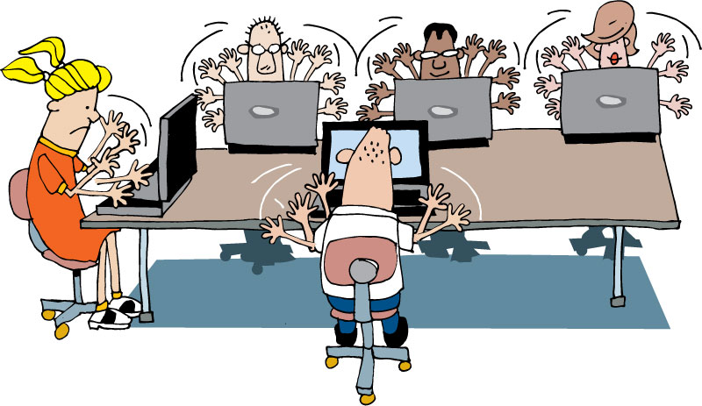
Tips for collaboration
NOT Us versus Them
NO excuses
Testing not just for testers!
Automation support
Environment set-up
Management support
End to end scenario creation
Notes:
Approach testing from a collaborative perspective
Shared commitment – all roles contribute to the quality of the solution
Testing moves from being a job title to a mindset of the team
It is not testers versus developers
Working together helps everybody on the team to improve their skills.
Use others strengths and let team members know yours to get the best result as a team.
No butt covering
Testing tasks do not always need to be done by testers:
Automation support from developers
Environment set-up and management support from sys admin
End to end scenario creation from BA etc.
-------------------------------------------------------------------------------------------------------------------------------------------------
Another key element to the Agile testing approach is to approach the practice from a collaborative perspective. With a shared commitment to quality, system administrators, analysts, developers and testers all collaborate in various ways to ensure the quality of the solution being developed. With this mindset, testing moves from being a job title to a skill which is scattered across the team based on the various strengths of the people involved.

Slide 13
The Testers Bill of Rights
And what about the right to suggest and challenge requirements???
You have the right to:
Ask questions of customers and programmers and receive timely answers
Bring up issues related to quality and process at any time
Ask for and receive help from anyone on the project team, including programmers, managers, and customers
The tools you need to do your job in a timely manner
“Testing Extreme Programming” – Lisa Crispin
Notes:
Discussion time……
Are these rights representative of how you work as a tester today?
Do you get access to the customer(s) or their proxies to ask questions?
Can you ask the developers for help in testing parts of the application?
Do you feel you have good tool support in the testing you do, or are you aware of considerably more effective tools you could use if they were available to you?
[CLICK]
Do you have the ability to suggest or challenge requirements. Should you?

Slide 14
Agile Automation
Notes:
Transparency is extended to how to report on Quality.

Slide 15
Why automation is important?
For faster feedback
Gives confidence to the development team
Testing a rapidly changing application manually is next to impossible
Notes:
Once you see a green bar for your functional test suite, developer is confident about his checkin
Faster feedback is one of the pillars of agile - automation helps to achieve the same.

Slide 16
Automation in an Agile team
What is different?
Automation happens parallel to development
Automate acceptance tests, more than end-to-end tests (in general)
Automated tests form a regression test suite and is executed in CI to give faster feedback

Slide 17
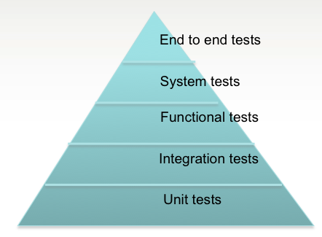
How much to automate?
Answer: It depends!
But, what we suggest is -

Slide 18
99 Test Balloons
exercise
Divide into groups of 4 per group
Create as many balloons that look like the example balloon as you can in 2 minutes
Have fun!
Notes:
Directions:
Start by showing the teams a balloon that you would like created. The balloon has a face made up of two round eyes, a triangular nose, and a semi circle mouth. Without any further instructions, tell the teams that they have 2 minutes to create as many of the balloons as possible, then have them bring the balloons up to be ‘accepted’. Eliminate any balloons that do not meet your criteria of ~10 inches wide, ~2 inch eyes, ~1 inch gap between eyes, ~1.5 inch high nose, and ~4.5 inch wide mouth. Very few teams will have balloons that meet the criteria.
As you reject their work (waste), ask the teams if they’ve ever had a similar experience in software development. Before the second round, give the teams 2 minutes to discuss how they can improve for the next iteration. They should start asking more questions about the acceptance criteria, which you will happily offer. When round 2 starts, the teams will now apply the acceptance criteria to their work and some will even start building ‘test harnesses’ (e.g. paper templates for face, quick ways to measure balloon width, etc.) . The results should be better in round 2. Discuss how they changed the way they worked and what improvements they would make the next time. If needed, play one more round. This time, every team should be using a test harness and should therefore be producing balloons with much more efficiency and quality.

Slide 19
Metrics
Notes:
Transparency is extended to how to report on Quality.

Slide 20
Testing Metrics
Go back to your pair (or triplet) where you described different types of testing.
On the back of each card, explain or show how you measure this testing method.
What outcome are you trying to measure?
Be prepared to share.
Notes:
Prioritize stories into Minimum Marketable Features (MMF)

Slide 21
Metrics and reporting: goals
Answer these questions
How busy is Testing?
What is the quality of the software?
What is the level of risk in the software?
What is our progress?
How good is our testing?
Notes:
Reporting metrics that answer these questions
Pairing metrics with answering these questions gives more context
----------------------------------------------------------------------------------------------------------------
So hopefully we’re all of the opinion that without context metrics can paint misleading or even downright incorrect pictures of the state of the software being tested. An alternative approach is to pair whatever metrics are being used with answers to these five questions. Each one reports on a different aspect of the testing process and give the ability to provide the context that is so often missing from pure metric-based reporting.
Obviously these questions will produce subjective opinions in the answers, but even this subjectivity along with frequent reporting and established trust should give a accurate representation of the testing efforts.

Slide 22
Metrics and reporting: goals
Answer these questions
How busy is Testing?
What is the quality of the software?
What is the level of risk in the software?
What is our progress?
How good is our testing?
Notes:
How busy is testing?
This allows the IM to understand if testers need help or if testers can help somewhere else
Burn up. Shows the total test to be completed and what remains.
Stories w/out test cases may mean that the testers are behind in writing test cases or something else.
----------------------------------------------------------------------------------------------------------------
So hopefully we’re all of the opinion that without context metrics can paint misleading or even downright incorrect pictures of the state of the software being tested. An alternative approach is to pair whatever metrics are being used with answers to these five questions. Each one reports on a different aspect of the testing process and give the ability to provide the context that is so often missing from pure metric-based reporting.
Obviously these questions will produce subjective opinions in the answers, but even this subjectivity along with frequent reporting and established trust should give a accurate representation of the testing efforts.

Slide 23
Metrics and reporting: goals
Answer these questions
How busy is Testing?
What is the quality of the software?
What is the level of risk in the software?
What is our progress?
How good is our testing?
Notes:
Severity of defects found.
How bad from a technical perspective.
Defect finder rating.
Failed tests by functional area
Priority of defects found.
What order defects should be fixed
Biz, customer, product manager rating.
----------------------------------------------------------------------------------------------------------------
So hopefully we’re all of the opinion that without context metrics can paint misleading or even downright incorrect pictures of the state of the software being tested. An alternative approach is to pair whatever metrics are being used with answers to these five questions. Each one reports on a different aspect of the testing process and give the ability to provide the context that is so often missing from pure metric-based reporting.
Obviously these questions will produce subjective opinions in the answers, but even this subjectivity along with frequent reporting and established trust should give a accurate representation of the testing efforts.

Slide 24
Metrics and reporting: goals
Answer these questions
How busy is Testing?
What is the quality of the software?
What is the level of risk in the software?
What is our progress?
How good is our testing?
Notes:
Stories bouncing back to development means that something is not right with the acceptance criteria or the dev work.
Stories without test cases is obvious risk that functionality is not being tested.
----------------------------------------------------------------------------------------------------------------
So hopefully we’re all of the opinion that without context metrics can paint misleading or even downright incorrect pictures of the state of the software being tested. An alternative approach is to pair whatever metrics are being used with answers to these five questions. Each one reports on a different aspect of the testing process and give the ability to provide the context that is so often missing from pure metric-based reporting.
Obviously these questions will produce subjective opinions in the answers, but even this subjectivity along with frequent reporting and established trust should give a accurate representation of the testing efforts.

Slide 25
Metrics and reporting: goals
Answer these questions
How busy is Testing?
What is the quality of the software?
What is the level of risk in the software?
What is our progress?
How good is our testing?
Notes:
Kind of a burn up for the total project.
By functional area, how many points are in testing now.
----------------------------------------------------------------------------------------------------------------
So hopefully we’re all of the opinion that without context metrics can paint misleading or even downright incorrect pictures of the state of the software being tested. An alternative approach is to pair whatever metrics are being used with answers to these five questions. Each one reports on a different aspect of the testing process and give the ability to provide the context that is so often missing from pure metric-based reporting.
Obviously these questions will produce subjective opinions in the answers, but even this subjectivity along with frequent reporting and established trust should give a accurate representation of the testing efforts.

Slide 26
Metrics and reporting: goals
Answer these questions
How busy is Testing?
What is the quality of the software?
What is the level of risk in the software?
What is our progress?
How good is our testing?
Notes:
Very subjective
----------------------------------------------------------------------------------------------------------------
So hopefully we’re all of the opinion that without context metrics can paint misleading or even downright incorrect pictures of the state of the software being tested. An alternative approach is to pair whatever metrics are being used with answers to these five questions. Each one reports on a different aspect of the testing process and give the ability to provide the context that is so often missing from pure metric-based reporting.
Obviously these questions will produce subjective opinions in the answers, but even this subjectivity along with frequent reporting and established trust should give a accurate representation of the testing efforts.

Slide 27
Defects

Slide 28

Defects
“A defect is behavior in a ‘Done’ story that violates valid expectations of the [Customer]”
Elisabeth Hendrickson
Not all defects need to be logged.
Only capture defects if they wont be fixed right away.
You want developers to feel comfortable showing you something that is not complete to get some guidance.
Notes:
Elisabeth Hendrickson
Runs a company called Quality Tree Software
Started in 1997
In 2003 became active in the agile community
How well would your organisation react to the “not all defects need to be logged” suggestion? Is this way of working in line with the cultural values of your employer.
How would your manager react?
Are you currently being measured, either explicitly or implicitly, on the number of defects you find?
Finally, what would the developers think?

Slide 29
When to raise a defect
Ready
In Dev
Ready for Test
In Test
Done
A
B
D
E
G
H
Found a problem here?
Push story back but do not create defect
or
For minor issues create defect
and let story pass (if business agree)
F
Found a problem here?
Raise and track the defect
C
Notes:
Minimize the cost of managing defects
Zero tolerance approach to defects – fix then (during BA review).
Customer may make the defect a lower priority, but tech should consider severity when agreeing to let the defect go.
[CLICK]
Report a defect when its found after the story was considered ‘done’.
[CLICK]
Question about associating defects with stories.
Only if needed. Yes, when possible. Gives people context.
-----------------------------------------------------------------------------------------------------------------------------------------
For many Agile teams, the point at which a defect needs to be created and managed as such is when it has been found after initial testing and the story is considered to be “Done”. Ideally, this also coincides with the end of the iteration. The main thinking behind this approach is to take a (close to) zero tolerance approach to defects (i.e., fix then as found, before the story is completed) and to minimise the cost of managing an official defect.
At the customers’ discretion, defects may be allowed out of the iteration but the team should push back on this if the existence of these defects is causing other problems (i.e., consequential defects or confusion).

Slide 30
Defect management
Appears on story-wall as separate card
Prioritized by business over new functionality
Categorized as per usual
Should defects be estimated?
When raising a defect should you associate it with a story?
Notes:
Read through the bullets.
[CLICK]
Defects are typically not estimated. Options: a developer or set of devs are assigned to defects during an iteration.
[CLICK]
Yes, defects should be associated with a story when possible. It gives context.
A defect can be considered to just be a requirement that has yet to be implemented… and we already have an established Agile process for working with such requirements; stories and the story wall.

Slide 31

Common testing issues/smells
Is it really a defect?
Bouncing defects
Automation failures
Accepting stories, then raising defects
Repeating business logic in tests
Notes:
Experienced testers will have witnessed many or all of these smells (issues) at some point in their career, but this is by no means a definitive list of all the common testing problems that could happen. Indeed, many of these smells are symptomatic of issues deeper in the team that are manifesting itself in the testing space.
Effective Agile testing will often raise issues that have been previously hidden within dysfunctional teams or poorly managed projects.
Long debates over whether a defect is a real defect or just a valid interpretation of the requirements
Stories continually bouncing back and forth between Dev Complete and In Testing columns on the storywall
Continuous failing of (long running) automation suite, leading to increase in regression defects
Accepting stories and raising defects
Repeating same business logic in the tests. Possible indicator that tests have not been refactored, team not doing TDD and/or that business logic is being tested in the wrong place (or multiple places). E.g., integration test that validates whether calculation works, and a GUI test does the same thing.
Only a single test case created for each acceptance criterion

Slide 32
Questions?
Planning the Project

